Slide 1

Credit Card Fraud Detection Using Machine Learning

Slide 2
Group Members:
Anil Kumar Boggavarapu
700731647 axb16470@ucmo.edu
Satya Ishyanth Kadali
700735513 sxk55130@ucmo.edu
Pranav Garipelli
700741488 pxg14880@ucmo.edu

Slide 3
Responsibilities and Contribution in project:
Description | Responsibility - Task | Responsibility - Person
Data Read and Preprocessing | Finding dataset, tuning and scaling features in dataset. | Pranav
Visualization and Data Transformation | Visualizing the data by using various visualizations techniques. | Anil Kumar
Model And Result Analysis | Analyzing of different fraud detection models. | Satya Ishyanth

Slide 4
Motivation:
Today, online buying has become a widespread daily purchase habit.
The perpetrators are engaging in malicious operations such as Trojan and spoofing.
Criminals steal cardholder information, the increase in fraud incidents has become a severe issue.
Credit card fraud detection is an important subject that has piqued the interest of the machine learning and computational intelligence fields.

Slide 5
Our Objective is to Implementing below Algorithm for fraud detection
Logistic Regression
SVM (Support Vector Machine)
DT (decision-tree)
XGBoost

Slide 6
Related work:
The publicly available datasets on credit card fraud are highly mismatched.
We analyse the most essential variables that may contribute to improved credit card fraudulent transaction detection accuracy.
This study made use of a credit card fraud detection dataset.
Oversampling was accomplished using the "Synthetic Minority Over Sampling Technique (SMOTE)." The dataset was split into two parts: training and testing data.

Slide 7
Problem Statement:
Online transactions are fast rising, and credit cards will be used mostly. Loss of physical credit cards or loss of credit card information will result in a substantially higher payment.
The hackers are there to commit fraud against people. As a result, there was a requirement to detect fraudulent transactions and safeguard online credit card transactions.
The problem with the credit card detection algorithm is the data itself. Around the world fraud transactions happen at very low rate when compared to the legit transactions.

Slide 8
Proposed Solution:
To overcome the problem wit the dataset, we using Synthetic Minority Over Sampling Technique (SMOTE).
Using XGBoost reduces the risk of overfitting the dataset, as in Gradient Boosting.
It also provides the added benefit of handling missing values on its own. Therefore, it will increase the performance of the fraud detection.

Slide 9
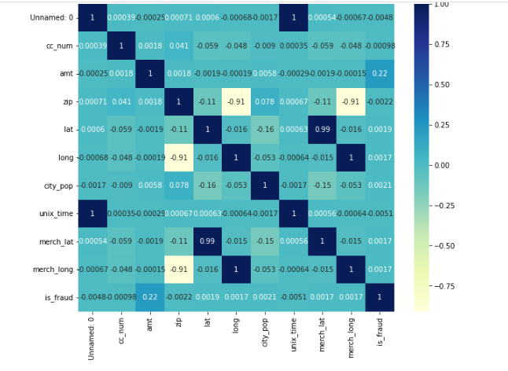
Simulations:
Correlation Matrix

Slide 10
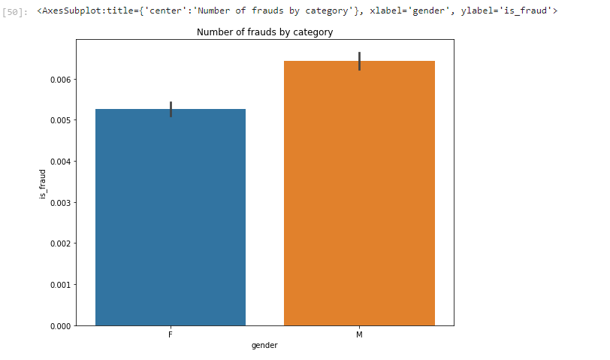
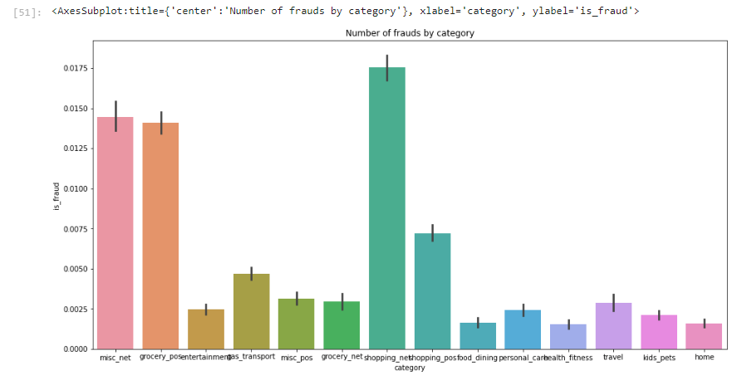
Box Plot
Bar Graph

Slide 11
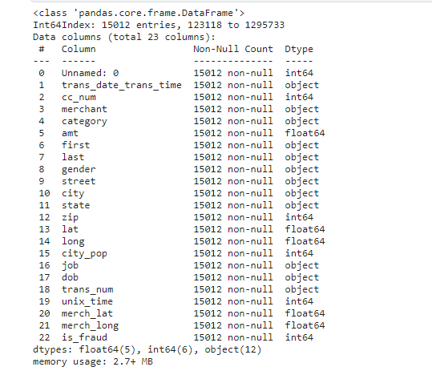
Data Columns

Slide 12
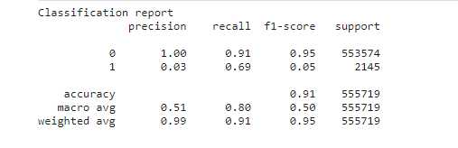
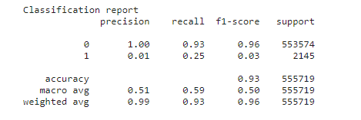
Bar Graph
Bar Graph

Slide 13
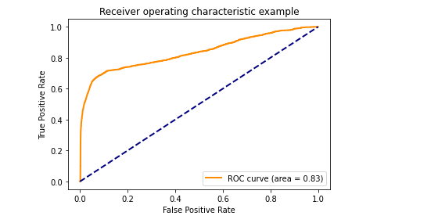
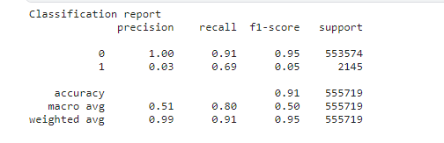
Logistic Regression
LR Report

Slide 14
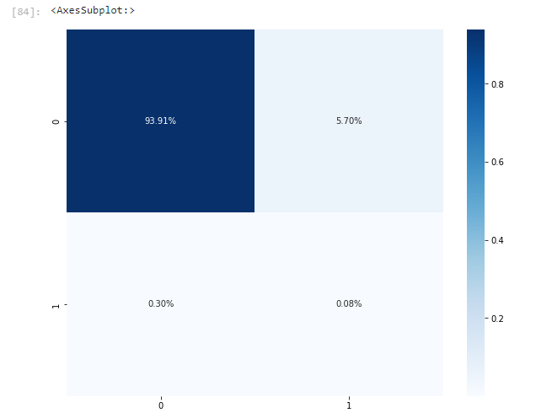
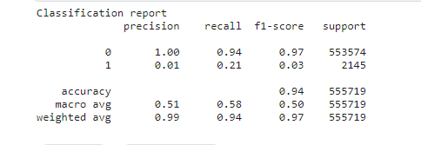
XGBoost
Confusion Matrix
Classification Report

Slide 15
References:
[1] S. Bachmayer, "Artificial Immune Systems," pp. 119-131 in Artificial Immune Systems, vol. 5132, 2008.M. Krivko, "A Hybrid Model for Plastic Card Fraud, "Expert Systems with Applications, vol. 37, no. 8, pp. 6070-6076, August 2010.
[2] S. Bhattacharyya, S. Jha, K. Tharakunnel, and J. C. Westland, "Data mining for credit card fraud: A comparative study,"
[3] Decision Support Systems, vol. 50, no. 3, Feb. 2011, pp. 602-613.
[4] "Plastic card fraud detection via peer group analysis," Advances in Data Analysis and Classification, vol. 2, no. 1, pp. 45-62, Mar. 2008.
[5] O. S. Yee, S. Sagadevan, N. Hashimah, and A. Hassain, "Credit Card Fraud Detection Using Machine Learning As A Tool”.

Slide 16
[6] Global Facts (2019). Topic: Startups worldwide. [online] Available at:
https://www.statista.com/topics/4733/startupsworldwide/ [Accessed 10 Jan. 2020].
[7] Legal Dictionary (2019). Fraud - Definition, Meaning, Types, Examples of fraudulent activity. [online] Available at: https://legaldictionary.net/fraud/ [Accessed 15 Jan. 2020].
[8] A. Mishra, C. Ghorpade, “Credit Card Fraud Detection on the Skewed Data Using Various Classification and
Ensemble Techniques” 2018 IEEE International Students' Conference on Electrical, Electronics and Computer Science (SCEECS) pp. 1-5. IEEE.
[9] M. Krivko, “A hybrid model for plastic card fraud detection systems,” Expert Systems with Applications, vol. 37, no. 8, pp. 6070–6076, Aug. 2010.

Slide 17
Thank You

